Slide 1
MGT 4140 Business Modeling Final Exam Review Apr 25, 2022

Slide 2
MGT 4140 Business Modeling Course Overview

Slide 3
Deterministic Models vs. Probabilistic (Stochastic) Models
Deterministic Models
are models in which all relevant data are assumed to be known with certainty.
can handle complex situations with many decisions and constraints
are very useful when there are few uncontrolled model inputs that are uncertain.
are useful for a variety of management problems.
are easy to incorporate constraints on variables.
software is available to optimize constrained models.
allows for managerial interpretation of results.
constrained optimization provides useful way to frame situations.
will help develop your ability to formulate models in general.

Slide 4
Deterministic Models vs. Probabilistic (Stochastic) Models
Probabilistic (Stochastic) Models
are models in which some inputs to the model are not known with certainty.
uncertainty is incorporated via probabilities on these “random” variables.
very useful when there are only a few uncertain model inputs and few or no constraints.
often used for strategic decision making involving an organization’s relationship to its environment.

Slide 5
Classification of Models
Methodologies
1. Qualitative
Delphi Methods
2. Quantitative - Non-statistical
Using “comparables”
3. Quantitative - Statistical
Time-series
Regression
By problem type
Forecasting
Decision Analysis
Constrained Optimization
Monte Carlo Simulation
By data type
Time series
Exponential smoothing
Moving average
Cross sectional
Multiple linear regression
By causality
Causal: causal variable
Non-causal: surrogate variable

Slide 6
The Modeling Process Quantitative - Statistical
Describe Problem / opportunity
Identify Overall Objective
Organize Sub-Objectives into a hierarchy
Objective
Hierarchies
Variables
and Attributes
Identify Model’s Objective
Determine all variables and their attributes
Decide on Measurement / Data Collection
Influence
Diagrams
Graphically depict relationships among variables
Distinguish between Decision and outcome variables
Mathematical
Representation
Determine mathematical relationships among variables
Develop mathematical model(s)
Testing and
Validation
Evaluate reliability and validity
Understand limitations
Implementation
and use
Implement models in DSSs
Clarify assumptions, inputs, and outputs

Slide 7




The Modeling Process Quantitative – Non-Statistical
Managerial Approach to Decision Making
Manager analyzes
situation (alternatives)
These steps
Use
Spreadsheet
Modeling
Makes decision to
resolve conflict
Decisions are
implemented
Consequences of decision

Slide 8
The Modeling Process
As applied to the first two stages of decision making
Model
Analysis
Results
Symbolic
World
Abstraction
Interpretation
Real
World
Management
Situation
Intuition
Decisions

Slide 9
The Modeling Process
The Role of Managerial Judgment in the Modeling Process:
Analysis
Model
Results
Symbolic
World
Abstraction
Managerial
Judgment
Interpretation
Real
World
Management
Situation
Decisions
Intuition

Slide 10
Modeling and Real World Decision Making
Management
Lingo
Modeling Term
Formal Definition
Example
Decision Variable Lever Controllable Exogenous Investment
Input Quantity Amount
Parameter Gauge Uncontrollable Exogenous Interest Rate
Input Quantity
Consequence Outcome Endogenous Output Commissions
Variable Variable Paid
Performance Yardstick Endogenous Variable Return on
Measure Used for Evaluation Investment
(Objective Function Value)

Slide 11
Breakeven
Sales – Costs = Profit
B/E is the point at which you are not making or losing $
Must Account for Fixed and Variable costs
Example:
Suppose we own a hotel, and our rooms rent for $50 per night. Our total fixed costs are $1,000 and out Variable costs are $10 per room. What is the break-even?

Slide 12
Crossover
Determining the point where two alternatives yield equal results
You have the option of subcontracting to improve room quality. Fixed Costs would increase to $1800, with no change to variable costs. You will, however, be able to charge $70 per room per day. At what point will you be indifferent between your current mode of operation and the new option?
Solution: Set the profit equations equal to each other

Slide 13
Pricing Models Example
Going back to our hotel room example, suppose the demand is:
Demand=200-3*Price
What price would you charge to maximize profits?

Slide 14
Pricing Models Equation
The profit equation would be:
Demand = 200-3P
Revenue = P(200-3P) = -3P²+200P
Fixed cost = 1,000
Var Cost = 10(200-3P)
Total Cost = 1,000+2000-30P
Profit = -3P²+200P-1,000-2,000+30P
= -3P²+230P-3,000

Slide 15
Pricing Models Slope
Maximum profit is where the slope is zero.
Slope can be calculated by taking the derivative of the profit equation.
Slope = -6P+230
Set the slope equation equal to zero and solve
Max profit is $38.33

Slide 16
Pricing Models Demand
To determine demand, plug the max profit price into the demand function…
Demand = 200 – 3P
Demand = 200 -115
Demand = 85 rooms

Slide 17
Example Problem 1 - Expected Value & Decision Tree

Slide 18
Expected Value

Slide 19
Decision Tree

Slide 20
Example Problem 2 - Sequential Decisions
Would you hire a consultant (or a psychic) to get more info about states of nature?
How would additional info cause you to revise your probabilities of states of nature occurring?
Draw a new tree depicting the complete problem.
Consultant’s Track Record
Z

Slide 21
Example Problem 2 - Sequential Decisions (Ans) Open MGT4140_03Joint_Probabilities_Table.xlsx
First thing you want to do is get the information (Track Record) from the Consultant in order to make a decision.
This track record can be converted to look like this:
P(F/S1) = 0.2 P(U/S1) = 0.8
P(F/S2) = 0.6 P(U/S2) = 0.4
P(F/S3) = 0.7 P(U/S3) = 0.3
F= Favorable U=Unfavorable
Next, you take this information and apply the prior probabilities to get the Joint Probability Table/Bayles Theorum
Z

Slide 22
Example Problem 2 - Sequential Decisions (Ans) Open MGT4140_03Joint_Probabilities_Table.xlsx
Next step is to create the Posterior Probabilities (You will need this information to compute your Expected Values)
P(S1/F) = 0.06/0.49 = 0.122
P(S2/F) = 0.36/0.49 = 0.735
P(S3/F) = 0.07/0.49 = 0.143
P(S1/U) = 0.24/0.51 = 0.47
P(S2/U) = 0.24/0.51 = 0.47
P(S3/U) = 0.03/0.51 = 0.06
Solve the decision tree using the posterior probabilities just computed.

Slide 23
Problem 1
Jenny Lind is a writer of romance novels. A movie company and a TV network both want exclusive rights to one of her more popular works. If she signs with the network, she will receive a single lump sum, but if she signs with the movie company the amount she will receive depends on the market response to her movie.
Jenny Lind – Potential Payouts
Movie company
Small box office - $200,000
Medium box office - $1,000,000
Large box office - $3,000,000
TV Network
Flat rate - $900,000
Questions:
How can we represent this problem?
What decision criterion should we use?

Slide 24
Jenny Lind – Payoff Table
Decisions | States of Nature
 | Small Box Office | Medium Box Office | Large Box Office
Sign with Movie Company | $200,000 | $1,000,000 | $3,000,000
Sign with TV Network | $900,000 | $900,000 | $900,000

Slide 25
Jenny Lind – Decision Tree
Small Box Office
$200,000
Sign with Movie Co.
Medium Box Office
$1,000,000
Large Box Office
$3,000,000
Small Box Office
$900,000
Sign with TV Network
Medium Box Office
$900,000
Large Box Office
$900,000

Slide 26
Bayes’ Theorem
Let the experiment be A and the prediction be B. Both have occurred, AB. The probability of both A and B together is P(AB). The law of conditional probability says that this probability can be found as the product of the conditional probability of one, given the other, times the probability of the other. That is
P(A|B) ´ P(B) = P(AB) = P(B|A) ´ P(A)
if both P(A) and P(B) are non zero.
Simple algebra shows that:
P(B|A) = P(A|B) ´ P(B) / P(A) equation 1
This is Bayes's Theorem. In words this says that the posterior probability of B (the updated prediction) is the product of the conditional probability of the experiment, given the influence of the parameters being investigated, times the prior probability of those parameters. (Division by the total probability of A assures that the resulting quotient falls on the [0, 1] interval, as all probabilities must.)

Slide 27
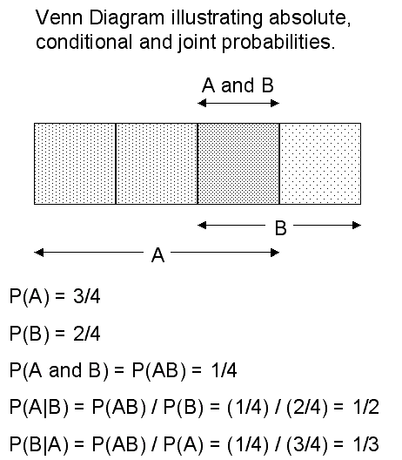
Bayes’ Theorem

Slide 28
Problem
A company is planning to market a new product. The company’s marketing vice-president is particularly concerned about the product’s superiority over the closest competitive product, which is sold by another company. The marketing vice-president assessed the probability of the new product’s superiority to be 0.7. This executive then ordered a market survey to determine the products superiority over the competition.
The results of the survey indicated that the product was superior to its competitor.
Assume the market survey has the following reliability:
If the product is really superior, the probability that the survey will indicate “superior” is 0.8.
If the product is really worse than the competitor, the probability that the survey will indicate “superior” is 0.3.
After completion of the market survey, what should the vice-president’s revised probability assignment to the event “new product is superior to its competitors”?

Slide 29
Joint Probability Table
 | P(Ai) | P(B|Ai) | P(Ai)* P(B|Ai) | Revised Probability P(Ai|B)
A1 Probability product is superior | 0.7 | 0.8 | 0.56 | 0.56/0.65 = 0.86
A2 Probability product is not superior | 0.3 | 0.3 | 0.09 | 0.09/0.65 = 0.14
 | 1.0 | P(B) = | 0.65

Slide 30
Optimization
Common elements of all optimization problems
Decision Variables - the variables whose values the decision maker is allowed to choose.
Objective Function - value that is to be optimized – maximized or minimized
Constraints that must be satisfied
Excel terminology for optimization
Decision variables = changing cells
Objective = target cell
Constraints impose restrictions on the values in the changing cells.

Slide 31
Optimization - Feasible solution
A common form for a constraint is nonnegativity
Nonnegativity constraints imply that changing cells must contain nonnegative values.
Two steps in solving an optimization problem.
Model development – decide what the decision variables are, what the objective is, which constraints are required and how everything fits together
Optimize – systematically choose the values of the decision variables that make the objective as large or small as possible and cause all of the constraints to be satisfied.
A feasible solution is any set of values of the decision variables that satisfies all of the constraints.
The set of all feasible solutions is called the feasible region.

Slide 32
Optimization - Infeasible solution
An infeasible solution is a solution where at least one constraint is not satisfied.
The optimal solution is the feasible solution that optimizes the objective.
An algorithm is basically a “plan of attack”. It is a prescription for carrying out the steps required to achieve some goal.
The simplex method is an algorithm that is suitable for linear models.
Excel’s Solver tool finds the best feasible solution with the most suitable algorithm.
There is really a third step in the optimization process: sensitivity analysis. This step allows us to ask a number of what-if questions about the completed model.

Slide 33
Example 1 - Spreadsheet Model
Common elements in all LP spreadsheet models are:
Inputs – all numeric data given in the statement of the problem (Blue border)
Changing cells – the values in these cells can be changed to optimize the objective (Red border)
Target(objective) cell – contains the value of the objective (Double line black boarder)
Constraints – specified in the Solver dialog box
Nonnegativity – check an option in a Solver dialog box to indicate nonnegative changing cells
Three stages of the complete solution:
Model development stage – enter all inputs, trial values for the changing cells, and formulas relating these in spreadsheet
Invoke Solver – designate the objective cell, changing cells, the constraints and selected options, and tell Solver to find the optimal solution.
Sensitivity analysis – see how the optimal solution changes as the selected inputs vary

Slide 34
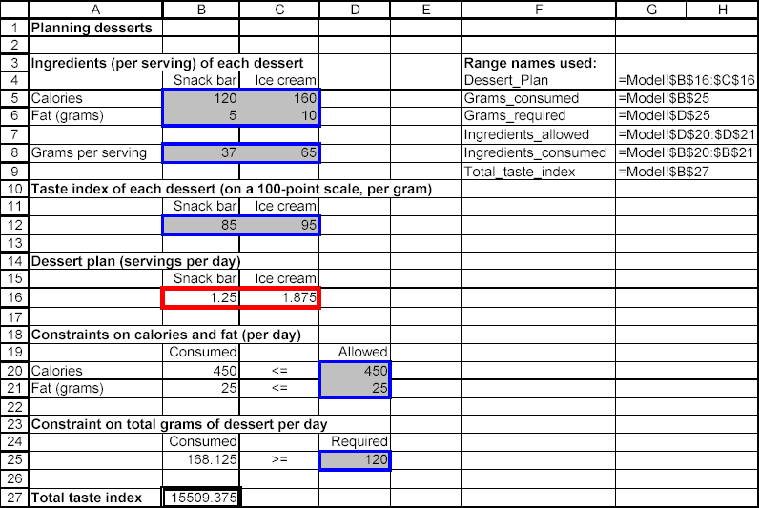
Example 1 - Spreadsheet Model
Optimal Solution for the Dessert Model
In this solution the calorie and fat constraints have been met exactly, thus they are binding. The constraint on grams in nonbinding, the positive difference in grams is called slack.

Slide 35
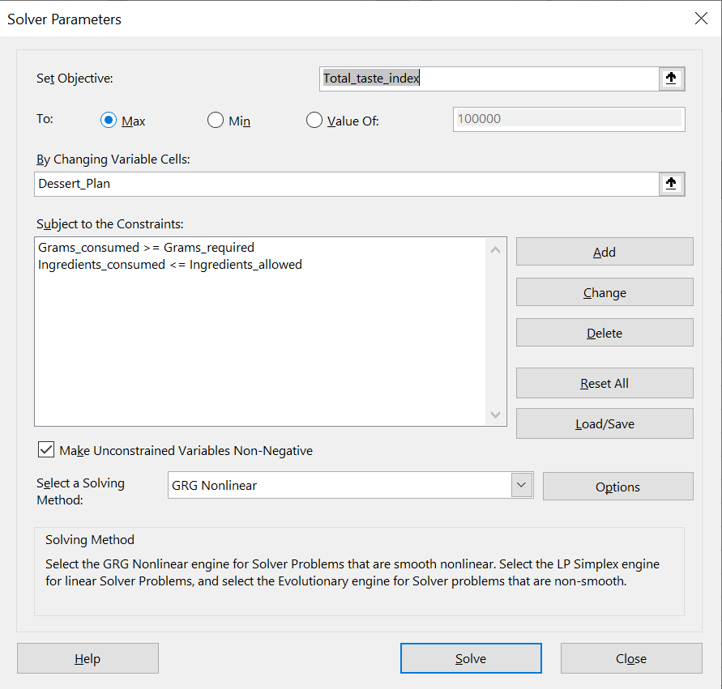
Example 1 - Spreadsheet Model
Solver dialog box for this model.

Slide 36
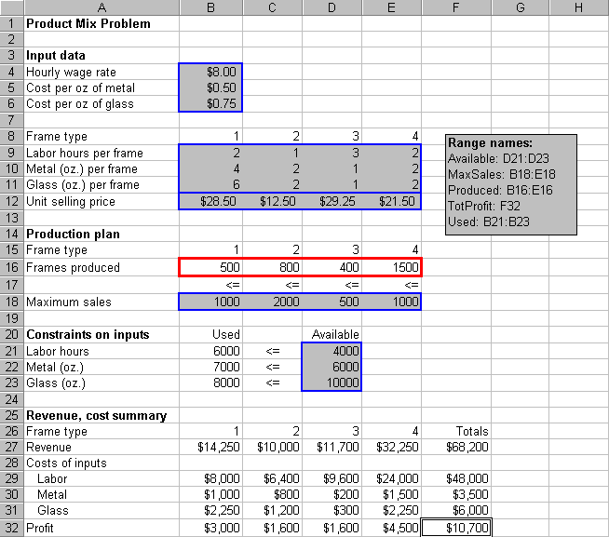
ProductMix.xlsx

Slide 37
Developing the Spreadsheet Model
Inputs. Enter the various inputs in the range B4:B6, B9:E12, B18:E18, and D21:D23.
Production levels. Enter any four values in cells B16:E16. These do not have to be the values shown. These cells are the changing cells; that is, the cells where the decision variables are placed. Any trail values can be used initially; Solver will eventually find the optimal values. Note that the four values shown in the initial solution cannot be optimal because they do not satisfy all of the constraints.
Resources used. Enter the formula =SUMPRODUCT(B9:E9,Produced) in cell B21 and copy it to the range B22:B23. These formulas calculate the units of labor, metal, and glass used by the current product mix. The SUMPRODUCT function is particularly helpful: it multiplies each value in the range by the corresponding value in the Products range and then sums these products.

Slide 38
Developing the Spreadsheet Model
Revenues, costs and profits. The area from row 25 down shows the summary of monetary values. Actually, all we need is the total profit in cell F32, but it is useful to calculate the ingredients of this total profit (that is, the revenues and costs associated with each product). To obtain the revenues enter the formula =B12*B16 in cell B27 and copy this to the range C27:E27. For the costs, enter the formula =$B$4*B$16*B9 in cell B29 and copy this to the range B29:E21.
Revenues, costs and profits. Then calculate profits for each product by entering the formula =B27-SUM(B29:B31) in cell B32 and copy this to range C32:E32. Finally, calculate the totals in column F by summing across each row with the SUM function.
The next step is to specify the changing cells, the objective cell, and the constraints in a Solver dialog box, and to instruct Solver to find the optimal solution. Before we do this, it is useful to try a few guesses in the changing cell.

Slide 39
Developing the Spreadsheet Model
Trying a few guesses has two purposes.
First, by entering different sets of values in the changing cells, we can confirm that the formulas in the other cells are working properly.
Second, is to provide a better understanding of the model
The resulting solution appears next.
The corresponding profit is $8750.

Slide 40
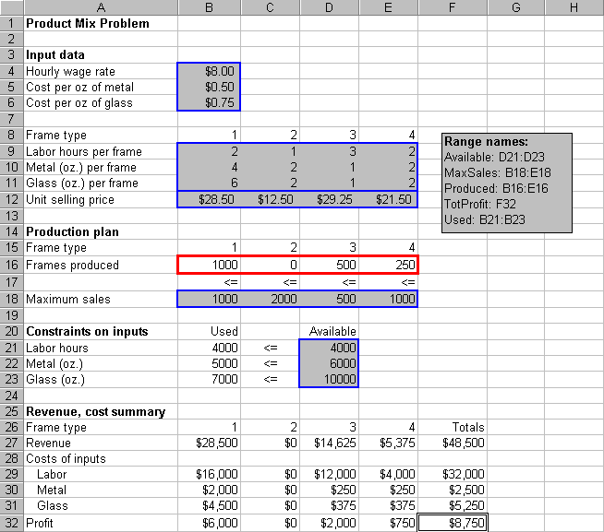
Developing the Spreadsheet Model

Slide 41
Developing the Spreadsheet Model
We have now produced as much as possible of the three frame type with the three highest profit margins. Does this guarantee that this solution is the best possible product? Unfortunately, it does not!
The solution is not optimal. Even in this small model it is difficult to guess the optimal solution, even when we use a relatively intelligent trial and error procedure.
The problem is that a frame type with a high profit margin can use up a lot of the resources and preclude other profitable frames from being produced.

Slide 42
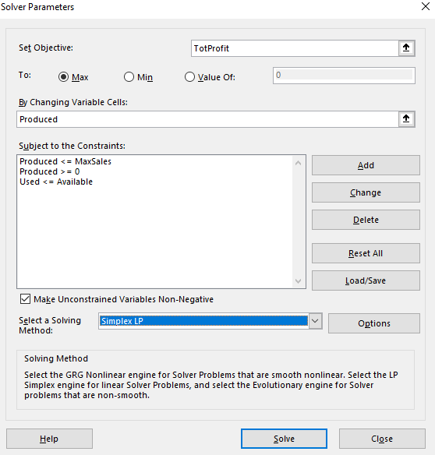
Developing the Spreadsheet Model – Using Solver
To invoke Excel’s Solver, select the Data/Solver menu item. This dialog box appears.

Slide 43
Developing the Spreadsheet Model – Using Solver
It has three important sections that you must fill in: the target cell, the changing cells, and the constraints.
For the product mix problem, we can fill these in by typing cell references or we can point, click and drag the appropriate range in the usual way.
Objective. Select TotProfit (cell F32) as the target cell, and click on the Maximize button.
Changing cells. Select the Produced range (B16:E16), the numbers of frames to produce, as the changing cells.
Constraints. Click on the Add button to add the following constraints: Used <= Available Produced < = MaxSales The first constraint says to use no more of each resource than is available. The second constraint say to produce no more of each product than can be sold.

Slide 44
Developing the Spreadsheet Model – Using Solver
Nonnegativity. Although negative production quantities obviously make no sense, we must tell Solver explicitly to make changing cells nonnegative. There are two ways to do this:
we can add another constraint in Step 3: Produced >=0.

Slide 45
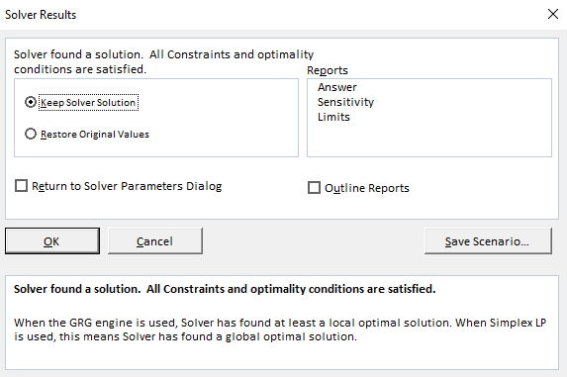
Developing the Spreadsheet Model – Using Solver
Linear model. There is one last step before clicking on the Solve button. Solvers uses one of the several numerical methods to solve various type of problems. Linear problems can be solved most efficiently by the simplex method. We must check the Assume Linear Model in the Solver options.
Optimize. Click on the Solve button.
At this point, Solver searches through a number of possible solutions until it finds the optimal solution. When it finishes it displays this message.

Slide 46
Developing the Spreadsheet Model – Using Solver
You can tell it to return the values in the changing cells to their original values or retain the optimal values found by Solver.
In some cases Solver is not able to find an optimal solution, in which case one of several error messages will appear.
For now, clicking on the OK button to keep the Solver Solution. You should see the solutions shown on the next slide.
The optimal plan is to produce 1000 type 1 frames, 800 type 2 frames, 400 type 3 frames, and no type 4 frames.
This is close to the production plan, but the current plan earns $450 more profit.
Also, it uses all available labor hours and metal, but only 8000 of the 10,000 ounces of glass available.

Slide 47
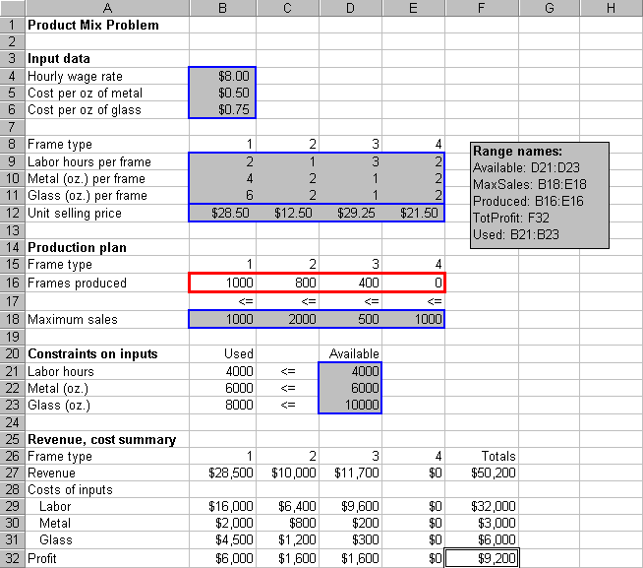
Developing the Spreadsheet Model – Using Solver

Slide 48
Developing the Spreadsheet Model – Using Solver
Finally, in terms of maximum sales, the optimal plan could produce more of frame types 2, 3, 4 (if there were more skilled labor and/or metal available).
This is typical of an LP solution.
Some of the constraints are met exactly; that is, as equalities, while others contain a certain amount of “slack”.

Slide 49
Develop the Model
To develop this model, proceed as follows.
Inputs. Enter the unit shipping costs, plant capacities region demands in the shaded ranges.
Shipping Plan. Enter any trial values for the shipments from each plant to each regions in the Shipping_plan range.
Numbers shipped from plants. Need to calculate the amount shipped out of each plant with row sums in the range G13:G15.
Amounts received by regions. Calculate the amount shipped to each region with columns sums in the range C16:F16.
Total shipping cost. Calculate the total cost of shipping power. TotalCost cell with the formula =SUMPRODUCT(C6:F8,Shipping_plan).
Invoke the Solver with the appropriate settings.

Slide 50
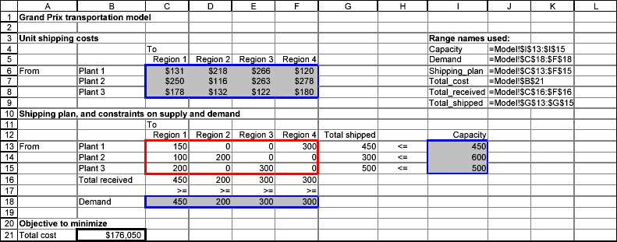
Spreadsheet Model

Slide 51
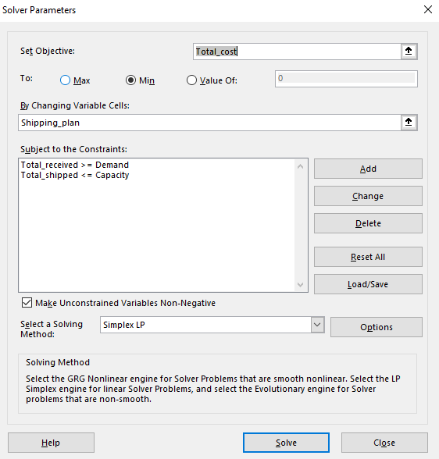
Spreadsheet Model
A good shipping plan tries to use cheap routes, but it is constrained by capacities and demands.
It is typical in transportation models, especially large models, that only a relatively few of the possible routes are used.

Slide 52
Sensitivity Analysis
Many sensitivity analyses could vary any one of the unit shipping costs, capacities, or demands. Many of these would use Solver’s sensitivity report.
One interesting analysis that cannot be performed with Solver’s tool is to keep shipping costs and capacities constant and allow all of the demands to change by a certain percentage.
Use SolverTable, with varying percentages as the single input.
The key to doing this correctly is to modify the model slightly before running SolverTable.

Slide 53
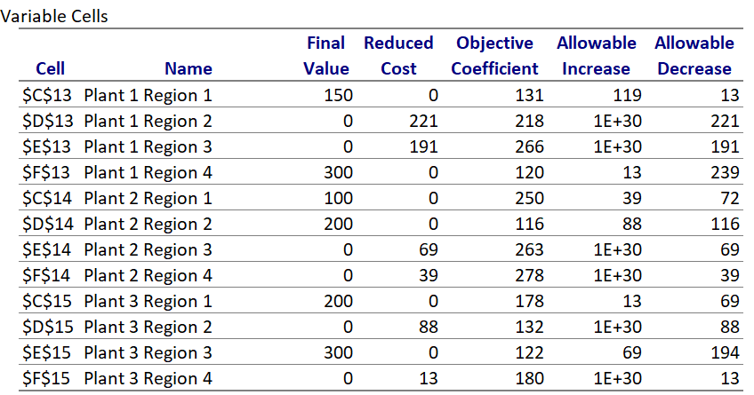
Sensitivity Analysis – Variable Cells
1
2
3

Slide 54
1. Reduced Cost
1. Reduced Cost
The reduced costs tell us how much the objective coefficients (unit shipping cost) can be increased or decreased before the optimal solution changes.
The primary values of interest in the variable cells section of the sensitivity report are the “Reduced Cost” values for each of the decision variables chosen in the linear programing model. The reduced cost value for each decision variable tells you how much your objective function value (i.e. minimize total cost) will change for a one unit increase in that decision variable.

Slide 55
2. Objective Coefficient
2. Objective Coefficient – unit shipping costs
The Objective Coefficient is the coefficient of the decision variables in the linear programing equation that you set up and ran on solver.
You were trying to minimize cost in this example. The costs considered the shipping plan and unit shipping costs. The Objective Coefficient of 131 indicates that for each unit of decision variable A, which is the number of units Plant 1 Region 1 produce in this example, your cost (unit shipping cost) went up by 131.
However, this Objective Coefficient value has not considered the opportunity cost of producing one additional unit. The reduced cost discussed above has considered the opportunity cost of producing that unit too.

Slide 56
3. Allowable Increase and Allowable Decrease
3. Allowable Increase and Allowable Decrease
The allowable increase and allowable decrease values tell you how much the objective coefficient of a decision variable can change before the recommended solution (decision variables) will change. In other words, if the objective coefficient of decision A increases by an amount less than the allowable increase, the recommended solution to the model/problem (optimal decision variables) will not change.
In this example, you will note that the allowable increase for decision variable B (Plant 1 Region 2) is a very large number and the allowable increase for decision variable A (Plant 1 Region 1) is 119. This indicates that the recommended decision variables will not change even if B increases by a very large amount. Whereas if the objective coefficient of decision A increases by lets say 119 units or more, the recommended solution to the model/problem (optimal decision variables) will change.
However, if the objective coefficient decreases by 13 units for A or 221 units for B, you will see that the optimal solution recommended will change from what is recommended now.

Slide 57
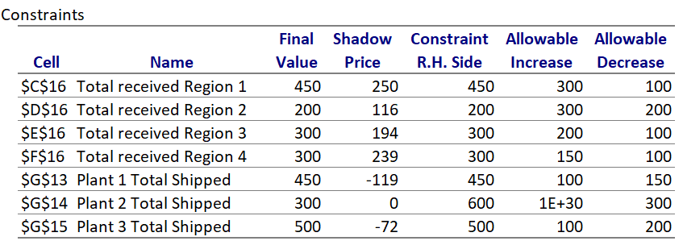
Sensitivity Analysis – Constraints
4
5
6

Slide 58
4. Shadow Price
4. Shadow Price
The primary values of interest in the Constraints section of the sensitivity report are the “Shadow Price” values for each of the constraints in the linear programing model. The shadow price for each constraint variable tells you how much your objective function value (i.e. minimize total cost) will change for a one unit increase in that constraint.
The shadow prices tell us how much the optimal solution can be increased or decreased if we change the right-hand side values (resources available or capacity) with one unit.

Slide 59
4. Shadow Price
4. Shadow Price
Note that we have no shadow price for Plant 2 Total Shipped but have a shadow price of 250, 116, 194 and 239 for Total received Region 1, 2, 3 and 4 respectively.
Notice, the constraints section, if the final value and the right hand side value of Total received Region 1 is 450 indicating we have used all the available resources we have. The shadow price of 250 for the Total received Region 1 in this example indicates that for every additional unit of resources we obtain will result in an increase of 250 in the objective value. This shadow price indicates our total cost (objective function) will increase by $250 for every additional unit of Total received Region 1 resources added.
On the other hand, a shadow price of zero for the Plant 2 Total Shipped indicates that an additional unit of resource does not reduce our costs or objective function. Notice, the constraints section, that the final value of Plant 2 Total Shipped is 300 whereas the right hand side constraint is 600. This indicates that we have not used all the resources we have and explains why we have a shadow price of zero!

Slide 60
5. Constraint R.H. Side
5. Constraint R.H. Side
The R.H. Side constraint is the right-hand side of that constraint equation in the linear programing model that you set up and ran on solver.
You were told in the example you had only 450, 600 and 500 units available in Plant 1, 2 and 3 respectively.
In addition, you were told that the maximum number demanded was 450, 200, 300 and 300 for Region 1, 2, 3 and 4 respectively. These are the values you find in the R.H. Side constraint.

Slide 61
6. Allowable Increase and Allowable Decrease
6. Allowable Increase and Allowable Decrease
The allowable increase and allowable decrease values tell you how much the right-hand side constraint can change before the shadow price becomes unreliable (or changes).
In other words, if the right-hand side constraint increases by an amount less than the allowable increase, the shadow price will not change and is relevant.
However, if the right-hand side constraint increases by an amount greater than the allowable increase or decreases by an amount more than the allowable decrease, the shadow price changes and will not hold any more.

Slide 62
6. Allowable Increase and Allowable Decrease
6. Allowable Increase and Allowable Decrease
In our example, you will note that the allowable increase for Total received Region 1 is 300 and allowable decrease is 100. This indicates that as long as the resources available increases by less than 300 or decreases by less than 100, the shadow price of 250 holds true.
Since the shadow price holds within this range, we can estimate the increase in costs if we add 10 units using the shadow price and know that the costs go up by 10*250= 2500! However, if the resource availability increased by 301 units, the shadow price of 250 will not be valid anymore and we cannot estimate the total cost using the shadow price of 250.

Slide 63
Agenda
Simulation
Problems

Slide 64
Simulation
What is a simulation?
Imitation or representation, as of a potential situation or in experimental testing.
Representation of the operation or features of one process or system through the use of another: computer simulation of an in-flight emergency.
What does random mean?
Benefits to simulation:
Time can be compressed
Simulations do not disrupt ongoing activities of the real system
Simulations can be used to analyze transient (infrequent) conditions
Developing a simulation model can lead to better understanding of the real system

Slide 65
Simulation
Why simulate?
Safety – flight simulator
Cost – easier to simulate adding a new runway and find out effects than to implement in reality and then find out
Time – Boeing uses simulated manufacturing before the real thing, with tremendous savings in time and money – can discover parts that do not fit and fix them before actual production
How?
Uses mathematical models
Probabilistic (as opposed to deterministic)
Uses the entire range of possible values of a variable in the model
Imitates a system or situation (like a coin-flip, or how long a person might have to wait in a line at a restaurant)

Slide 66
Simulation
Simulation requires you to know
What variable is to be simulated
Is the variable discrete or continuous?
The distribution of the variable – values it can take on and the probabilities of those values occurring.
Step 1: Generate a variable containing uniformly distributed random variables between 0 and 1 (the rand() function in Excel).
Step 2: Create a rule to map the random numbers to values of the variable desired in the right proportion, and apply the rule.

Slide 67
Types of Simulations
Simulation
Discrete
2-Value
Multi-Valued
Continuous

Slide 68
Types of Simulations 2-Value: Coin Toss
Create a column of random numbers from 0 to 1
How would you assign a value to heads and tails?
Heads
Tails
0.0
.5
1.0

Slide 69
Types of Simulations Multi-Valued
Suppose we put 100 colored balls in a bag and randomly pull them out.
Color # Probability Cumulative
Red 25 25% .25
Blue 42 42% .67
Yellow 33 33% 1.0
Red
Blue
Yellow
0.0 .25 .67 1.0
=if(f7<=c$7,“Red”,if(f7<=c$8,“Blue”,“Yellow”))

Slide 70
Types of Simulations Multi-Valued
Using vlookup, where does Red start?
Grades example.
Equal distribution of grades A through F:
=randbetween(50,100)
F
D
C
B
A
50 60 70 80 90 100

Slide 71
Probability Distribution
A probability distribution defines the behavior of a variable by defining its limits, central tendency and nature
Mean
Standard Deviation
Upper and Lower Limits
Continuous or Discrete
Examples are:
Normal Distribution (continuous)
Binomial (discrete)
Poisson (discrete)
Uniform (continuous or discrete)
Custom (created to suit a specific purpose)

Slide 72

Uniform Distribution
All values between minimum and maximum occur with equal likelihood
Conditions
Minimum Value is Fixed
Maximum Value is Fixed
All values occur with equal likelihood
Excel function: RAND() – returns a uniformly distributed random number in the range (0,1)

Slide 73
Agenda
Continuous Variables
Queuing Systems

Slide 74
Continuous Variable – Arrival Time
Variable to be simulated is arrival time at a restaurant which can literally take on infinite individual values
For example: someone could arrive at:
12:09:37
12:09:37:52
12:09:37:52:14, etc.
To simulate this situation, we must specify intervals
At the restaurant the intervals could be all people arriving between 11am and 12pm, 12pm and 1pm, or 1pm and 2pm.
As with the coin toss, generate random numbers in Excel ( =RAND() )
Make a rule – if random number:
<=.333, then =11am-12pm
>.333 up to =.666, then 12pm-1pm
>.666 up to 1, then 1pm to 2pm
each category is equally likely

Slide 75
Continuous Variable – Arrival Time
If the random number is.47, then this would fall in the 12pm to 1pm category,
If the random number is .88, then this would fall in the 1pm to 2pm category, etc.
Because each category is equally likely, if we run enough trials, each category will contain about the same number of random numbers, which will tell the restaurant owner that it is equally likely that a person will arrive at any of the three times.
The owner looks at historical information and says that on an average day, 225 people eat lunch at his restaurant , and that typically
47 people arrive between 11am and 12pm
112 people arrive between 12pm and 1pm
66 people arrive between 1pm and 2pm
How do we map these numbers?

Slide 76
Continuous Variable – Arrival Time
To complete the mapping, we need to make a cumulative distribution function (CDF)

Slide 77
Continuous Variable – Arrival Time
Make a new rule – if random number:
<=.21, then =11am-12pm
>.21 up to =.71, then 12pm-1pm
>.71 up to 1, then 1pm to 2pm

Slide 78
Normal Distribution
Conditions:
Uncertain variable is symmetric about the mean
Uncertain variable is more likely to be in vicinity of the mean than far away
Use when:
Distribution of x is normal (for any sample size)
Distribution of x is not normal, but the distribution of sample means (x-bar) will be normally distributed with samples of size 30 or more (Central Limit Theorem)
Excel function: NORMSDIST() – returns a random number from the cumulative standard normal distribution with a mean of zero and a standard deviation of one [e.g., NORMSDIST(1) = .84]

Slide 79
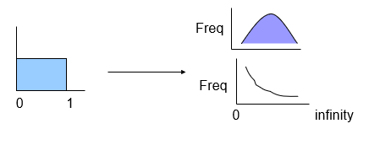
Other Distributions
Variables to be simulated may be normal (e.g. height) or exponential (e.g. service time) or various other distributions.
Task is to convert uniform distribution to the required distribution.

Slide 80
Queuing Systems
A queuing system is any system where entities (people, trucks, jobs, etc.) wait in line for service (processing of some sort) - retail checkout lines, jobs on a network server, phone switchboard, airport runways, etc.
Inputs
Queuing (waiting line) systems are characterized by:
Number of servers / number of queues
SSSQ – Single Server Single Queue
SSMQ – Single Server Multiple Queue
MSSQ – Multiple Server Single Queue
MSMQ - Multiple Server Multiple Queue
Arrival Rate (Arrival Intervals)
Service Rate (Service Times)

Slide 81
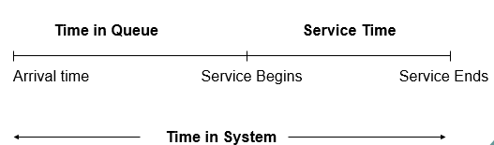
Queuing Systems
Outcome
Performance of a queuing system is measured by
Average time waiting in queue/system
Average number of entities in queue/system

Slide 82
Distribution in Queuing
Arrival Intervals (time between two consecutive arrivals) and Service Time (time to serve one customer) are exponentially distributed.
Confirm it yourself by watching cars on a street!
Sample Problem
A loading dock (SSSQ) has trucks arriving every 36 minutes (0.6 hrs) on average, and the average service (loading / unloading) time is 30 minutes (0.5 hrs). A new conveyer belt system can reduce that to 15 minutes (0.25 hours). Simulate the arrival of 200 trucks to see how performance would be affected by the new system.

