Slide 1
MGT 4140 Business Modeling Continuous Variables Apr 11, 2022

Slide 2
Agenda
Continuous Variables
Queuing Systems

Slide 3
Continuous Variable – Arrival Time
Variable to be simulated is arrival time at a restaurant which can literally take on infinite individual values
For example: someone could arrive at:
12:09:37
12:09:37:52
12:09:37:52:14, etc.
To simulate this situation, we must specify intervals
At the restaurant the intervals could be all people arriving between 11am and 12pm, 12pm and 1pm, or 1pm and 2pm.
As with the coin toss, generate random numbers in Excel ( =RAND() )
Make a rule – if random number:
<=.333, then =11am-12pm
>.333 up to =.666, then 12pm-1pm
>.666 up to 1, then 1pm to 2pm
each category is equally likely

Slide 4
Continuous Variable – Arrival Time
If the random number is.47, then this would fall in the 12pm to 1pm category,
If the random number is .88, then this would fall in the 1pm to 2pm category, etc.
Because each category is equally likely, if we run enough trials, each category will contain about the same number of random numbers, which will tell the restaurant owner that it is equally likely that a person will arrive at any of the three times.
The owner looks at historical information and says that on an average day, 225 people eat lunch at his restaurant , and that typically
47 people arrive between 11am and 12pm
112 people arrive between 12pm and 1pm
66 people arrive between 1pm and 2pm
How do we map these numbers?

Slide 5
Continuous Variable – Arrival Time
To complete the mapping, we need to make a cumulative distribution function (CDF)

Slide 6
Continuous Variable – Arrival Time
Make a new rule – if random number:
<=.21, then =11am-12pm
>.21 up to =.71, then 12pm-1pm
>.71 up to 1, then 1pm to 2pm

Slide 7
Normal Distribution
Conditions:
Uncertain variable is symmetric about the mean
Uncertain variable is more likely to be in vicinity of the mean than far away
Use when:
Distribution of x is normal (for any sample size)
Distribution of x is not normal, but the distribution of sample means (x-bar) will be normally distributed with samples of size 30 or more (Central Limit Theorem)
Excel function: NORMSDIST() – returns a random number from the cumulative standard normal distribution with a mean of zero and a standard deviation of one [e.g., NORMSDIST(1) = .84]

Slide 8
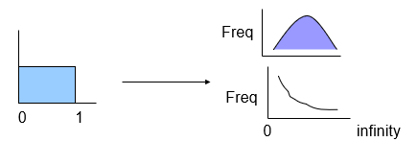
Other Distributions
Variables to be simulated may be normal (e.g. height) or exponential (e.g. service time) or various other distributions.
Task is to convert uniform distribution to the required distribution.

Slide 9
Agenda
Queuing Systems
Continuous Variables

Slide 10
Queuing Systems
A queuing system is any system where entities (people, trucks, jobs, etc.) wait in line for service (processing of some sort) - retail checkout lines, jobs on a network server, phone switchboard, airport runways, etc.
Inputs
Queuing (waiting line) systems are characterized by:
Number of servers / number of queues
SSSQ – Single Server Single Queue
SSMQ – Single Server Multiple Queue
MSSQ – Multiple Server Single Queue
MSMQ - Multiple Server Multiple Queue
Arrival Rate (Arrival Intervals)
Service Rate (Service Times)

Slide 11
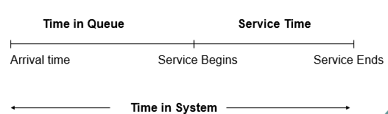
Queuing Systems
Outcome
Performance of a queuing system is measured by
Average time waiting in queue/system
Average number of entities in queue/system

Slide 12
Distribution in Queuing
Arrival Intervals (time between two consecutive arrivals) and Service Time (time to serve one customer) are exponentially distributed.
Confirm it yourself by watching cars on a street!
Sample Problem
A loading dock (SSSQ) has trucks arriving every 36 minutes (0.6 hrs) on average, and the average service (loading / unloading) time is 30 minutes (0.5 hrs). A new conveyer belt system can reduce that to 15 minutes (0.25 hours). Simulate the arrival of 200 trucks to see how performance would be affected by the new system.

Slide 13
Simulating Exponential Distributions
To convert the uniform distribution of the random numbers to an exponential distribution, take the negative natural log of the random numbers.
This creates an exponential distribution with an average of 1.00.
To get an average of 0.6 (to represent average arrival interval in hours), simply multiply result by 0.6.
Thus, the conversion formula is:
ln(rand())*µ
where µ is the mean of the exponential distribution desired.

Slide 14
Sample Conversion
Average:
0.500645 | 1.040982
Random | -ln(rand())
0.449796 | 0.798962
0.858464 | 0.15261
0.828061 | 0.188668
0.938751 | 0.063206
0.84637 | 0.166798
0.428408 | 0.847678
0.357574 | 1.028412
0.63932 | 0.447351
0
1
0
infinity
…..
…..

Slide 15
Other Distributions
To convert uniform distribution to the required distribution: use =NORMINV(rand(),mean,standard deviation)

