Slide 1
MGT 4140
Business Modeling
Network Model
Mar 21, 2022

Slide 2
Agenda
Network Model
Transportation Model
Sensitivity Analysis

Slide 3
Network Models
Reasons to distinguish network models from other LP models
  Network structure of these models allows us to represent them graphically.
  Many companies have real problems that can be represented as network models.
  Specialized solution techniques have been developed specifically for network models.

Slide 4
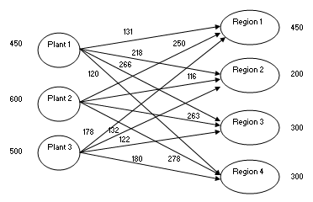
Network Model
This model is typical of network models.

Slide 5
Network Model
A node, indicated by a circle, generally represents a geographical location.
An arc, indicated by an arrow, generally represents a route for getting a product from one node to another.
The decision variables are usually called flows. They represent the amounts shipped on the various arcs.
Upper limits are called arc capacities, and they can also be shown on the model.

Slide 6
Agenda
Network Model
Transportation Model
Sensitivity Analysis

Slide 7
Transportation Models
Companies produce products at locations called origins and ships these products to customer locations called destinations.
Each origin has a limited amount that it can ship, and each customer destination must receive a required quantity of the product.
Only possible shipments are those directly from an origin to a destination.
These problems are generally called transportation problems.

Slide 8
Assignment Models
Assignment models are used to assign, on a one-to-one basis, members of one set to members of another set in a least-cost (or least-time) manner.
Assignment models are special cases of transportation models where all flows are 0 or 1.
It is identical to the transportation model except with different inputs.
The only minor difference is that the demand constraints “=” constraints, because each job must be completed exactly once.

Slide 9
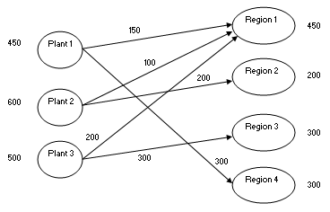
Example
The company manufactures automobiles in three plants and then ships them to four regions of the country.

Slide 10
Example
Grand Prix wants to find the lowest-cost shipping plan for meeting the demands of the four regions without exceeding capacities of the plants.
The company must decide exactly the number of autos to send from each plant to reach region – a shipping plan.
A typical transportation problem requires three sets of numbers:
  Capacities (or supplies) – indicates the most each plant can supply in a given amount of time.
  Demands ( or requirements) – typically estimated from some type of forecasting model. Often demands are based on historical customer demand data.
  Unit shipping (and possibly production) costs – come from a transportation cost analysis.

Slide 11
Develop the Model
To develop this model, proceed as follows.
  Inputs. Enter the unit shipping costs, plant capacities region demands in the shaded ranges.
  Shipping Plan. Enter any trial values for the shipments from each plant to each regions in the Shipping_plan range.
  Numbers shipped from plants. Need to calculate the amount shipped out of each plant with row sums in the range G13:G15.
  Amounts received by regions. Calculate the amount shipped to each region with columns sums in the range C16:F16.
  Total shipping cost. Calculate the total cost of shipping power. TotalCost cell with the formula =SUMPRODUCT(C6:F8,Shipping_plan).
Invoke the Solver with the appropriate settings.

Slide 12
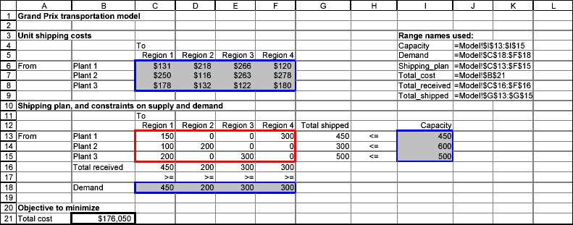
Spreadsheet Model

Slide 13
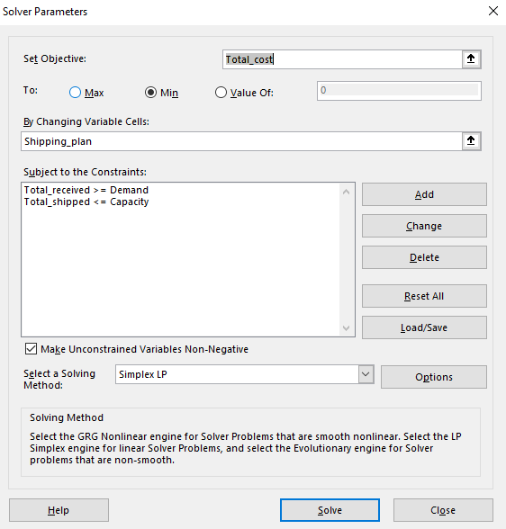
Spreadsheet Model
A good shipping plan tries to use cheap routes, but it is constrained by capacities and demands.
It is typical in transportation models, especially large models, that only a relatively few of the possible routes are used.

Slide 14
Agenda
Network Model
Transportation Model
Sensitivity Analysis

Slide 15
Sensitivity Analysis
Many sensitivity analyses could vary any one of the unit shipping costs, capacities, or demands. Many of these would use Solver’s sensitivity report.
One interesting analysis that cannot be performed with Solver’s tool is to keep shipping costs and capacities constant and allow all of the demands to change by a certain percentage.
Use SolverTable, with varying percentages as the single input.
The key to doing this correctly is to modify the model slightly before running SolverTable.

Slide 16
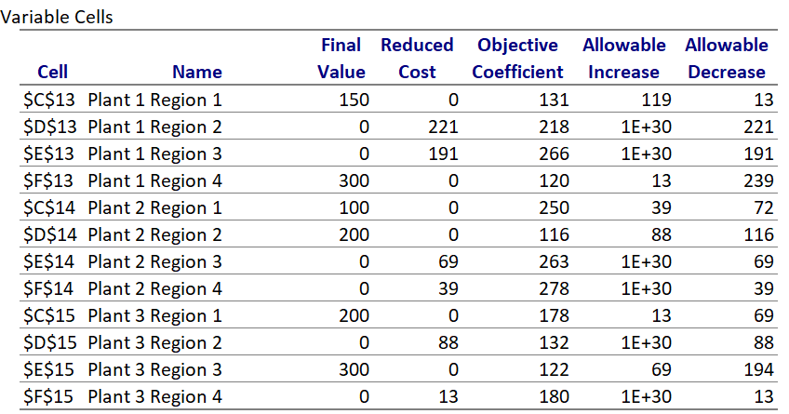
Sensitivity Analysis – Variable Cells
1
2
3

Slide 17
1. Reduced Cost
1. Reduced Cost
  The reduced costs tell us how much the objective coefficients (unit shipping cost) can be increased or decreased before the optimal solution changes.
  The primary values of interest in the variable cells section of the sensitivity report are the “Reduced Cost” values for each of the decision variables chosen in the linear programing model. The reduced cost value for each decision variable tells you how much your objective function value (i.e. minimize total cost) will change for a one unit increase in that decision variable.

Slide 18
2. Objective Coefficient
2. Objective Coefficient – unit shipping costs
  The Objective Coefficient is the coefficient of the decision variables in the linear programing equation that you set up and ran on solver.
  You were trying to minimize cost in this example. The costs considered the shipping plan and unit shipping costs. The Objective Coefficient of 131 indicates that for each unit of decision variable A, which is the number of units Plant 1 Region 1 produce in this example, your cost (unit shipping cost) went up by 131.
  However, this Objective Coefficient value has not considered the opportunity cost of producing one additional unit. The reduced cost discussed above has considered the opportunity cost of producing that unit too.

Slide 19
3. Allowable Increase and Allowable Decrease
3. Allowable Increase and Allowable Decrease
  The allowable increase and allowable decrease values tell you how much the objective coefficient of a decision variable can change before the recommended solution (decision variables) will change. In other words, if the objective coefficient of decision A increases by an amount less than the allowable increase, the recommended solution to the model/problem (optimal decision variables) will not change.
  In this example, you will note that the allowable increase for decision variable B (Plant 1 Region 2) is a very large number and the allowable increase for decision variable A (Plant 1 Region 1) is 119. This indicates that the recommended decision variables will not change even if B increases by a very large amount. Whereas if the objective coefficient of decision A increases by lets say 119 units or more, the recommended solution to the model/problem (optimal decision variables) will change.
  However, if the objective coefficient decreases by 13 units for A or 221 units for B, you will see that the optimal solution recommended will change from what is recommended now.

Slide 20
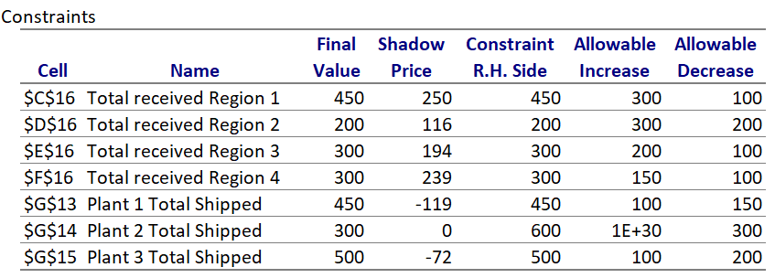
Sensitivity Analysis – Constraints
4
5
6

Slide 21
4. Shadow Price
4. Shadow Price
  The primary values of interest in the Constraints section of the sensitivity report are the “Shadow Price” values for each of the constraints in the linear programing model. The shadow price for each constraint variable tells you how much your objective function value (i.e. minimize total cost) will change for a one unit increase in that constraint.
  The shadow prices tell us how much the optimal solution can be increased or decreased if we change the right-hand side values (resources available or capacity) with one unit.

Slide 22
4. Shadow Price
4. Shadow Price
  Note that we have no shadow price for Plant 2 Total Shipped but have a shadow price of 250, 116, 194 and 239 for Total received Region 1, 2, 3 and 4 respectively.
  Notice, the constraints section, if the final value and the right hand side value of Total received Region 1 is 450 indicating we have used all the available resources we have. The shadow price of 250 for the Total received Region 1 in this example indicates that for every additional unit of resources we obtain will result in an increase of 250 in the objective value. This shadow price indicates our total cost (objective function) will increase by $250 for every additional unit of Total received Region 1 resources added.
  On the other hand, a shadow price of zero for the Plant 2 Total Shipped indicates that an additional unit of resource does not reduce our costs or objective function. Notice, the constraints section, that the final value of Plant 2 Total Shipped is 300 whereas the right hand side constraint is 600. This indicates that we have not used all the resources we have and explains why we have a shadow price of zero!

Slide 23
5. Constraint R.H. Side
5. Constraint R.H. Side
  The R.H. Side constraint is the right-hand side of that constraint equation in the linear programing model that you set up and ran on solver.
  You were told in the example you had only 450, 600 and 500 units available in Plant 1, 2 and 3 respectively.
  In addition, you were told that the maximum number demanded was 450, 200, 300 and 300 for Region 1, 2, 3 and 4 respectively. These are the values you find in the R.H. Side constraint.

Slide 24
6. Allowable Increase and Allowable Decrease
6. Allowable Increase and Allowable Decrease
  The allowable increase and allowable decrease values tell you how much the right-hand side constraint can change before the shadow price becomes unreliable (or changes).
  In other words, if the right-hand side constraint increases by an amount less than the allowable increase, the shadow price will not change and is relevant.
  However, if the right-hand side constraint increases by an amount greater than the allowable increase or decreases by an amount more than the allowable decrease, the shadow price changes and will not hold any more.

Slide 25
6. Allowable Increase and Allowable Decrease
6. Allowable Increase and Allowable Decrease
  In our example, you will note that the allowable increase for Total received Region 1 is 300 and allowable decrease is 100. This indicates that as long as the resources available increases by less than 300 or decreases by less than 100, the shadow price of 250 holds true.
  Since the shadow price holds within this range, we can estimate the increase in costs if we add 10 units using the shadow price and know that the costs go up by 10*250= 2500! However, if the resource availability increased by 301 units, the shadow price of 250 will not be valid anymore and we cannot estimate the total cost using the shadow price of 250.

