Slide 1
MGT 4140 Business Modeling Linear Programming Feb 28, 2022

Slide 2
Agenda
Linear Programming
Product Mix
Pricing Model

Slide 3
Linear Programming
Linear programming (LP) is a method of spreadsheet optimization.
LP is used in all type of organizations and it is used to solve an extremely wide variety of problems.
The simplex method is a systematic, arithmetic intensive search through the set of all possible solutions for the solution that optimizes a given objective.
We will not be using the simplex method; instead, we will learn to formulate problems as LP models.

Slide 4
Background - 1
The Monet Company produces four types of picture frames, which we label 1, 2, 3, and 4. The four types of frames differ in respect to size, shape, and materials used.
Each type requires a certain amount of skilled labor, metal, and glass as shown here. The table also lists the unit selling price Monet charges for each type of frame.

Slide 5
Background - 2
During the coming week Monet can purchase up to 4000 hours of skilled labor, 6000 ounces of metal, and 10,000 ounces of glass.
The unit costs are $8.00 per labor hour, $0.50 per ounce of metal and $0.75 per ounce of glass.
Also, market constraints are such that it is impossible to sell more than 1000 type 1 frames, 2000 type 2 frames, 500 type 3 frames, and 1000 type 4 frames.
The company wants to maximize its weekly profit.

Slide 6
Solution - 1
In the traditional algebraic solution method, we first identify the decision variables.
In this small problem they are the number of frames of type 1, 2, 3, and 4 to produce.
We label these x1, x2, x3, and x4.
Next, we write total profit and the constraints in terms of x’s.
Finally, since only nonnegative amounts can be produced, we add explicit constraints to ensure that the x’s are nonnegative.

Slide 7
Solution - 2
The resulting algebraic formulation is shown below:
maximize 6x₁ + 2x₂ + 4x₃ + 3x₄ (profit objective)
subject to 2x₁ + x₂ + 3x₃ + 2x₄ < = 4000 (labor constraint)
4x₁ + 2x₂ + x₃ + 2x₄ < = 6000 (metal constraint)
6x₁ + 2x₂ + x₃ + 3x₄ < = 10,000 (glass constraint)
x₁ < = 1000 (frame 1 sales constraint)
x₂ < = 2000 (frame 2 sales constraint)
x₃ < = 500 (frame 3 sales constraint)
x₄ < = 1000 (frame 4 sales constraint)
x₁, x₂, x₃, x₄ > = 0 (nonnegative constraint)

Slide 8
Solution - 3
To understand this formulation, consider the profit objective first.
The profit from x₁ frames of type 1 is 6x₁ because each frame contributes $6 to profit. This $6 is calculated as the unit selling price minus the cost of the inputs that go into a single type 1 frame: Unit profit = 28.50 - [2(8.00) + 4(0.50) + 6(0.75)] = $6
Profits for the other three types are obtained similarly. Their unit profits are $2.00, $4.00, and $3.00, respectively.
Then the total profit is the sum of the profits from the four products.
Next, consider the skilled labor constraint.
The right hand side, 4000, is the number of hours available. On the left-hand side each type 1 frame uses 2 hours of labor, so x₁ units require 2x₁ hours of labor.
Similar statements hold for the other three products, and the total number of labor hours used is the sum over the four products.
Then the constraint states that the number of hours cannot exceed the number of hours available.

Slide 9
Solution - 4
The constraints of metal and glass are similar. Finally, the maximum sales constraints and the nonnegativity constraints put upper and lower limits on the quantities that can be produced.
For many years all LP problems were formulated this way. Because of this, many commercial LP computer packages are written to accept LP problems in this format.
In the past 2 decades a more intuitive method of expressing LP problems has emerged. The method takes advantage of the power and flexibility of spreadsheets. Actually, LP problems could always be formulated on spreadsheets, but now with the addition of Solver add-ins, spreadsheets have the capability of solving LP problems as well. There are many ways to develop an LP spreadsheet model.

Slide 10
Spreadsheet Elements
The common elements in all LP spreadsheet model are the following:
Inputs. All numerical inputs - that is, the data needed to form the objective and the constraints - must appear somewhere in the spreadsheet. It is not necessary but it often helps to enclose inputs in a blue border with shading.
Changing cells. Instead of using variable names, such as x’s, there is a set of designated cells that play the role of the decision variables. These values in these cells can be changed to optimize the objective. In Excel these cells are called the changing cells. To designate these we often enclose them in a red border.
Target (objective) cell. One cell, called the target cell or the objective cell, contains the value of the objective. Solver systematically varies the values in the changing cells to optimize the value in the target cell. Our convention is to enclose the target cell within a black double line border.
Constraints. Excel does not show the constraints directly on the spreadsheet. Instead we specify constraints in a Solver dialog box.
Nonnegativity. Normally we want the decision variables - that is, the values in the changing cells - to be nonnegative. For certain versions of Excel these nonnegativity constraints might need to be specified explicitly.

Slide 11
Solution - 5
In general, the complete solution to the problem involve three stages.
The first stage is to enter all the inputs, trial values for the changing cells, and formulas relating these in a spreadsheet. We call this formulating the model.
This stage if the most crucial because it is here that all of the “ingredients” of the model are included and related appropriately.
In particular, the spreadsheet must include a formula that relates the objective to the changing cells, so that if the values in the changing cells vary, the objective value varies automatically.
After the model is formulated, we can proceed to the second stage: invoking Solver. At this point we formally designate the objective cell, the changing cell, and the constraints, and we tell solver to find the optimal solution.
If the first stage is done correctly, the second stage is usually very straightforward.

Slide 12
Solution - 6
The third stage is sensitivity analysis. In most model formulations of real problems, we make “best guesses” for the numerical inputs to the problem. There is typically some uncertainty about quantities such as the unit prices, forecasted demands, and resource availability.
When we use Solver to solve he problem, we use our best estimates of these quantities to obtain an optimal solution.

Slide 13
Agenda
Linear Programming
Product Mix
Pricing Model

Slide 14
ProductMix.xlsx
This file illustrates the solution procedure for Monet’s product mix problem.
The first stage is to set up the spreadsheet, as explained in step-by-step fashion.

Slide 15
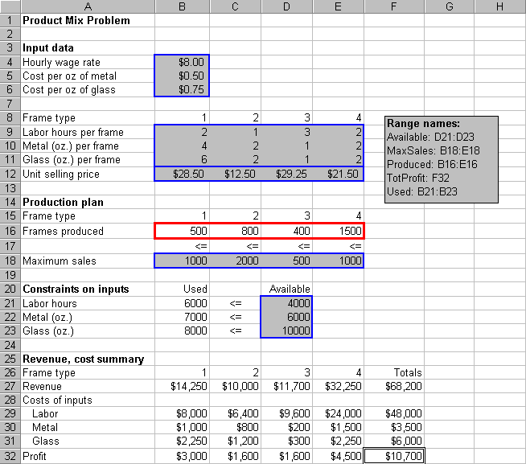
ProductMix.xlsx

Slide 16
Developing the Spreadsheet Model
Inputs. Enter the various inputs in the range B4:B6, B9:E12, B18:E18, and D21:D23.
Production levels. Enter any four values in cells B16:E16. These do not have to be the values shown. These cells are the changing cells; that is, the cells where the decision variables are placed. Any trail values can be used initially; Solver will eventually find the optimal values. Note that the four values shown in the initial solution cannot be optimal because they do not satisfy all of the constraints.
Resources used. Enter the formula =SUMPRODUCT(B9:E9,Produced) in cell B21 and copy it to the range B22:B23. These formulas calculate the units of labor, metal, and glass used by the current product mix. The SUMPRODUCT function is particularly helpful: it multiplies each value in the range by the corresponding value in the Products range and then sums these products.

Slide 17
Developing the Spreadsheet Model
Revenues, costs and profits. The area from row 25 down shows the summary of monetary values. Actually, all we need is the total profit in cell F32, but it is useful to calculate the ingredients of this total profit (that is, the revenues and costs associated with each product). To obtain the revenues enter the formula =B12*B16 in cell B27 and copy this to the range C27:E27. For the costs, enter the formula =$B$4*B$16*B9 in cell B29 and copy this to the range B29:E21.
Revenues, costs and profits. Then calculate profits for each product by entering the formula =B27-SUM(B29:B31) in cell B32 and copy this to range C32:E32. Finally, calculate the totals in column F by summing across each row with the SUM function.
The next step is to specify the changing cells, the objective cell, and the constraints in a Solver dialog box, and to instruct Solver to find the optimal solution. Before we do this, it is useful to try a few guesses in the changing cell.

Slide 18
Developing the Spreadsheet Model
Trying a few guesses has two purposes.
First, by entering different sets of values in the changing cells, we can confirm that the formulas in the other cells are working properly.
Second, is to provide a better understanding of the model
The resulting solution appears next.
The corresponding profit is $8750.

Slide 19
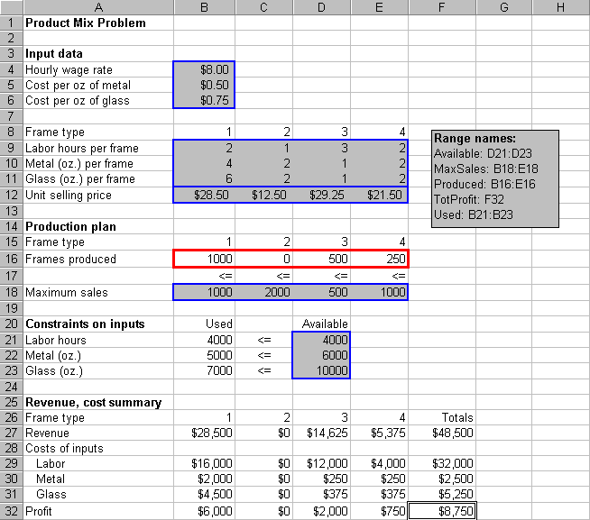
Developing the Spreadsheet Model

Slide 20
Developing the Spreadsheet Model
We have now produced as much as possible of the three frame type with the three highest profit margins. Does this guarantee that this solution is the best possible product? Unfortunately, it does not!
The solution is not optimal. Even in this small model it is difficult to guess the optimal solution, even when we use a relatively intelligent trial and error procedure.
The problem is that a frame type with a high profit margin can use up a lot of the resources and preclude other profitable frames from being produced.

Slide 21
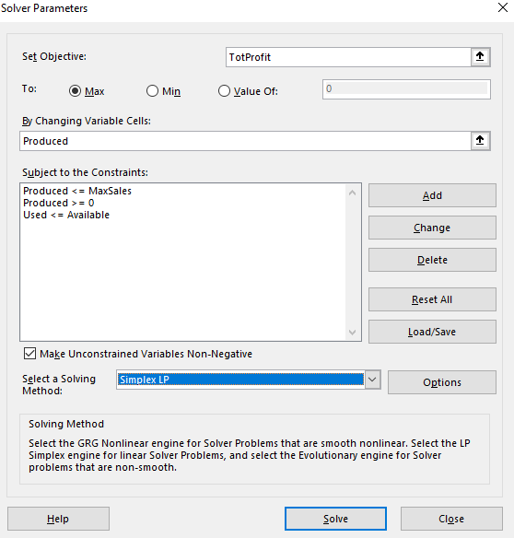
Developing the Spreadsheet Model – Using Solver
To invoke Excel’s Solver, select the Data/Solver menu item. This dialog box appears.

Slide 22
Developing the Spreadsheet Model – Using Solver
It has three important sections that you must fill in: the target cell, the changing cells, and the constraints.
For the product mix problem, we can fill these in by typing cell references or we can point, click and drag the appropriate range in the usual way.
Objective. Select TotProfit (cell F32) as the target cell, and click on the Maximize button.
Changing cells. Select the Produced range (B16:E16), the numbers of frames to produce, as the changing cells.
Constraints. Click on the Add button to add the following constraints: Used <= Available Produced < = MaxSales The first constraint says to use no more of each resource than is available. The second constraint say to produce no more of each product than can be sold.

Slide 23
Developing the Spreadsheet Model – Using Solver
Nonnegativity. Although negative production quantities obviously make no sense, we must tell Solver explicitly to make changing cells nonnegative. There are two ways to do this:
we can add another constraint in Step 3: Produced >=0.

Slide 24
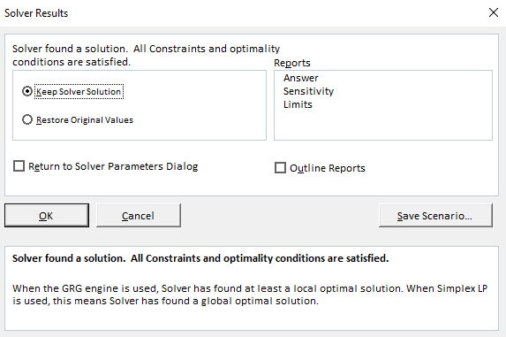
Developing the Spreadsheet Model – Using Solver
Linear model. There is one last step before clicking on the Solve button. Solvers uses one of the several numerical methods to solve various type of problems. Linear problems can be solved most efficiently by the simplex method. We must check the Assume Linear Model in the Solver options.
Optimize. Click on the Solve button.
At this point, Solver searches through a number of possible solutions until it finds the optimal solution. When it finishes it displays this message.

Slide 25
Developing the Spreadsheet Model – Using Solver
You can tell it to return the values in the changing cells to their original values or retain the optimal values found by Solver.
In some cases Solver is not able to find an optimal solution, in which case one of several error messages will appear.
For now, clicking on the OK button to keep the Solver Solution. You should see the solutions shown on the next slide.
The optimal plan is to produce 1000 type 1 frames, 800 type 2 frames, 400 type 3 frames, and no type 4 frames.
This is close to the production plan, but the current plan earns $450 more profit.
Also, it uses all available labor hours and metal, but only 8000 of the 10,000 ounces of glass available.

Slide 26
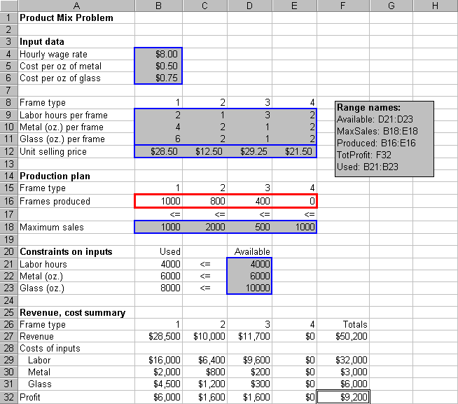
Developing the Spreadsheet Model – Using Solver

Slide 27
Developing the Spreadsheet Model – Using Solver
Finally, in terms of maximum sales, the optimal plan could produce more of frame types 2, 3, 4 (if there were more skilled labor and/or metal available).
This is typical of an LP solution.
Some of the constraints are met exactly; that is, as equalities, while others contain a certain amount of “slack”.

Slide 28
Agenda
Linear Programming
Product Mix
Experimenting

Slide 29
Experimenting
If we want to experiment with different inputs to this problem - the unit revenues or resources available, for example - we can simply change the inputs and then rerun Solver.
As a simple what-if example, consider the modified model in the output on the next slide.

Slide 30
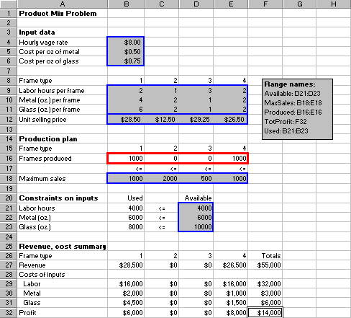
Solution to Product Mix with New Inputs

Slide 31
Experimenting
Here the unit price for frame type 4 has increased from $21.50 to $26.50, and all other inputs have remained the same.
By making type 4 frames more profitable, we might expect them to enter the optimal mix. This is exactly what happens.
The new optimal plan discontinues production of frame type 2 and 3, and instead calls for production of 1000 units of frame type 4.
There is one technical note you should be aware of.
Because of the way the numbers are stored and calculated on a computer, the optimal values in the changing cells and elsewhere can contain small roundoff errors.
For example for all practical purposes .000000008731 can be treated as 0.

