Slide 1
MGT 4140
Business Modeling
Introduction to Optimization
Feb 21, 2022

Slide 2
Agenda
Optimization
Sensitivity Analysis
Advertising Model

Slide 3
Optimization
Common elements of all optimization problems
  Decision Variables - the variables whose values the decision maker is allowed to choose.
  Objective Function - value that is to be optimized – maximized or minimized
  Constraints that must be satisfied
Excel terminology for optimization
  Decision variables = changing cells
  Objective = target cell
  Constraints impose restrictions on the values in the changing cells.

Slide 4
Optimization
- Feasible solution
A common form for a constraint is nonnegativity
Nonnegativity constraints imply that changing cells must contain nonnegative values.
Two steps in solving an optimization problem.
  Model development – decide what the decision variables are, what the objective is, which constraints are required and how everything fits together
  Optimize – systematically choose the values of the decision variables that make the objective as large or small as possible and cause all of the constraints to be satisfied.
A feasible solution is any set of values of the decision variables that satisfies all of the constraints.
The set of all feasible solutions is called the feasible region.

Slide 5
Optimization
- Infeasible solution
An infeasible solution is a solution where at least one constraint is not satisfied.
The optimal solution is the feasible solution that optimizes the objective.
An algorithm is basically a “plan of attack”. It is a prescription for carrying out the steps required to achieve some goal.
The simplex method is an algorithm that is suitable for linear models.
Excel’s Solver tool finds the best feasible solution with the most suitable algorithm.
There is really a third step in the optimization process: sensitivity analysis. This step allows us to ask a number of what-if questions about the completed model.

Slide 6
Example 1
- Two Variable Model
Maggie decided she must plan her desserts carefully. Maggie will allow herself no more than 450 calories and 25 grams of fat in her daily desserts. She requires at least 120 grams of desserts a day. Each dessert also has a “taste index”.
What should her daily dessert plan be to stay within her constraints and maximizes the total taste index of her dessert?
First step is to identify appropriate decision variables, the appropriate objective, the constraints and the relationships between them.

Slide 7
Example 1
- Algebraic Model
Identify the decision variable, write expressions from the total taste index and the constraints in terms of the x’s. Then add explicit constraints to ensure that the x’s are nonnegative.
Maximize 37(85)x₁ +65(95)x₂
Subject to:
120x₁+160x₂≤450
5x₁+10x₂≤25
37x₁+65x₂≥120
x₁,x₂ ≥ 0

Slide 8
Example 1
- Graphical Model
When there are only two decision variables the problem can be solved graphically.
To graph this, consider the associate equality (120x₁+160x₂=450) and find where the associated line crosses the axes.
Graph the constraints on the figure as shown on the next slide.
To see which feasible point maximizes the objective, draw a sequence of lines where, for each, the objective is a constant.
The last feasible point that it touches is the optimal point.

Slide 9
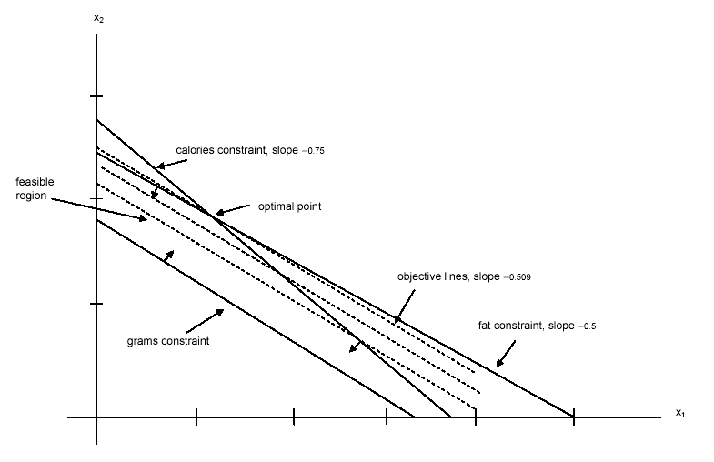
Example 1
- Graphical Model

Slide 10
Example 1
- Spreadsheet Model
Common elements in all LP spreadsheet models are:
  Inputs – all numeric data given in the statement of the problem (Blue border)
  Changing cells – the values in these cells can be changed to optimize the objective (Red border)
  Target(objective) cell – contains the value of the objective (Double line black boarder)
  Constraints – specified in the Solver dialog box
  Nonnegativity – check an option in a Solver dialog box to indicate nonnegative changing cells
Three stages of the complete solution:
  Model development stage – enter all inputs, trial values for the changing cells, and formulas relating these in spreadsheet
  Invoke Solver – designate the objective cell, changing cells, the constraints and selected options, and tell Solver to find the optimal solution.
  Sensitivity analysis – see how the optimal solution changes as the selected inputs vary

Slide 11
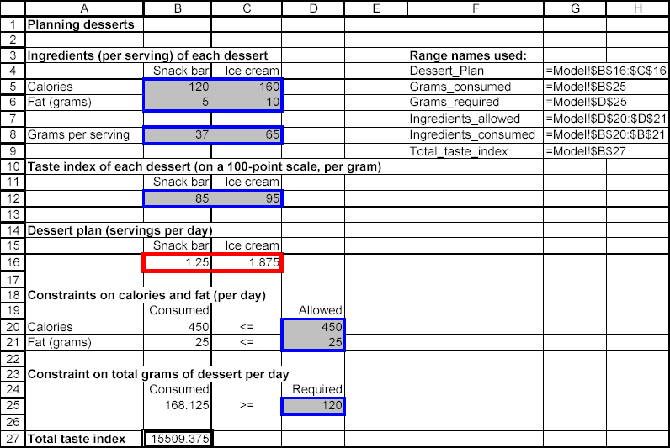
Example 1
- Spreadsheet Model
Optimal Solution for the Dessert Model
In this solution the calorie and fat constraints have been met exactly, thus they are binding. The constraint on grams in nonbinding, the positive difference in grams is called slack.

Slide 12
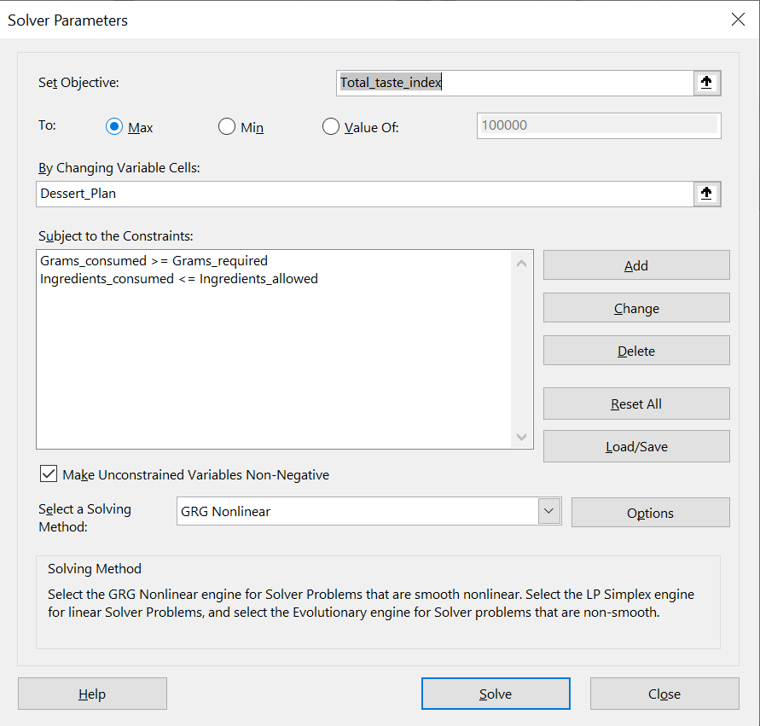
Example 1
- Spreadsheet Model
Solver dialog box for this model.

Slide 13
Agenda
Optimization
Sensitivity Analysis
Advertising Model

Slide 14
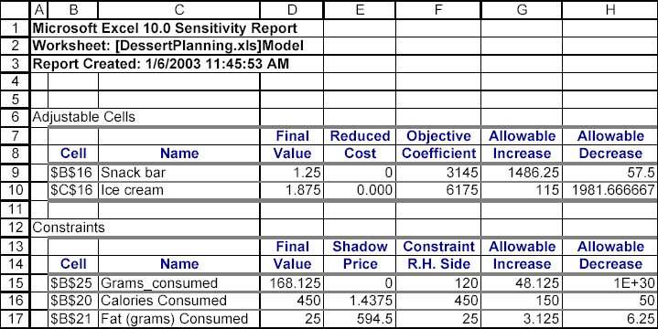
Sensitivity Analysis
Often it is useful to perform sensitivity analysis to see how (or if) the optimal solution changes as one or more inputs change.
The Solve dialog box offers you the option to obtain a sensitivity report.
Solver’s sensitivity report performs two types of sensitivity analysis:
  on the coefficients of the objectives, the c’s, and
  on the right hand sides of the constraints, the b’s.
The sensitivity report has two sections corresponding to the two types of analysis.

Slide 15
Sensitivity Analysis
The reduced cost for any decision not currently in the optimal solution indicates how much better that coefficient must be before that variable will enter at a positive level.
The term shadow price is an economic term. It indicates the change in the optimal value of the objective function when the right-hand side of some constraint changes by one unit.

Slide 16
Sensitivity Analysis
- Infeasibility and Unboundedness
It is possible that there are no feasible solutions to a model. There are generally two possible reasons for this:
  There is a mistake in the model (an input entered incorrectly) or
  the problem has been so constrained that there are no solutions left.
In general, there is no foolproof way to find the problem when a “no feasible solution” message appears.
A second type of problem is unboundedness.
Unboundedness is that the model can be made as large as possible. If this occurs it is likely that a wrong input has been entered or forgotten some constraints.
Infeasibility and unboundedness are quite different. It is possible for a model to have no feasible solution but no realistic model can have an unbounded solution.

Slide 17
Agenda
Optimization
Sensitivity Analysis
Advertising Model

Slide 18
Advertising Model
General Flakes Company advertises a low-fat breakfast cereal in a variety of 30 second television ads placed in a variety of television shows.
The ads in different shows vary by cost and by the type of viewers they are likely to reach.
  Viewers have been separated into six mutually exclusive categories.
The rating service can supply information on the number of viewers.
It wants to know how many ads to place on each of several television shows to obtain required exposures at minimum costs.
This model is essentially the opposite of the product mix model.
LP models ten to fall into “types” from a structural point of view, even though their actual contexts might be very different.

Slide 19
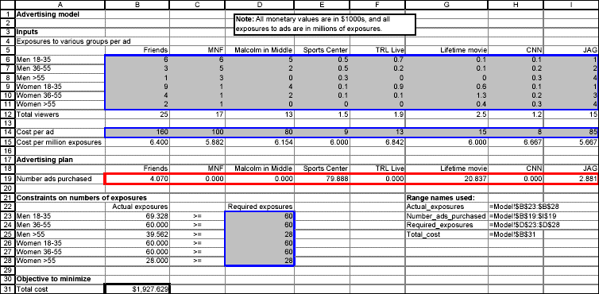
Advertising Model

Slide 20
Developing the Model
Follow these steps to develop the model:
  Input values and range names. Enter the inputs given.
  Ads purchased. Enter any values in the Number_ads_purchased range.
  Exposures obtained. Enter the formula =SUMPRODUCT(B6:I6,Number_ads_purchased) in cell B23 and copy it down to cell B28.
  Total cost. In cell B31 enter the formula =SUMPRODUCT(B14:I14,Number_ads_purchased)
The solution is not one that would be expected.

Slide 21
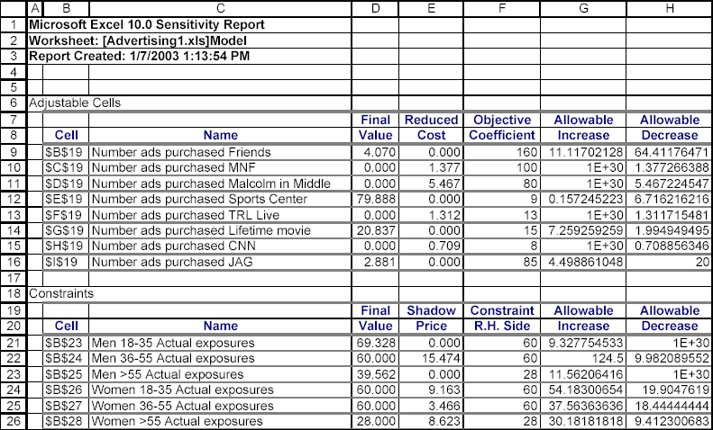
Sensitivity Analysis
Solver’s sensitivity report is enlightening for this solution.

Slide 22
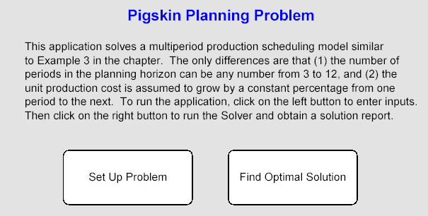
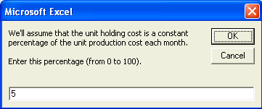
Decision Support System
Many people who are not experts need to use models.
It is useful to provide these users with a decision support system (DSS) that can help them solve problems without having to worry about technical details.
The users sees a “front end” and a “back end”.
  The front end allows them to select input values.
  The back end then produces a report that explains the optimal policy in nontechnical terms.
A “front-end” for a problem similar to the Pigskin model.

