Slide 1
MGT 4140 Business Modeling Decision Tree & Bayes’ Theorem Feb 7, 2022

Slide 2
Agenda
Decision Tree
Problems

Slide 3
Decision Trees
A method of visually structuring the problem
Effective for sequential decision problems
Two types of branches
Decision nodes
Choice nodes
Terminal points
Solving the tree involves pruning all but the best decisions
Completed tree forms a decision rule

Slide 4
Decision Nodes
Decision nodes are represented by Squares
Each branch refers to an Alternative Action
The expected return (ER) for the branch is
The payoff if it is a terminal node, or
The ER of the following node
The ER of a decision node is the alternative with the maximum ER

Slide 5
Chance Nodes
Chance nodes are represented by Circles
Each branch refers to a State of Nature
The expected return (ER) for the branch is
The payoff if it is a terminal node, or
The ER of the following node
The ER of a chance node is the sum of the probability weighted ERs of the branches
ER = Σ P(S_{i}) * V_{i}

Slide 6
Terminal Nodes
Terminal nodes are optionally represented by Triangles
The node refers to a payoff
The value for the node is the payoff

Slide 7
Problem 1
Jenny Lind is a writer of romance novels. A movie company and a TV network both want exclusive rights to one of her more popular works. If she signs with the network, she will receive a single lump sum, but if she signs with the movie company the amount she will receive depends on the market response to her movie.
Jenny Lind – Potential Payouts
Movie company
Small box office - $200,000
Medium box office - $1,000,000
Large box office - $3,000,000
TV Network
Flat rate - $900,000
Questions:
How can we represent this problem?
What decision criterion should we use?

Slide 8
Jenny Lind – Payoff Table
Decisions | States of Nature
 | Small Box Office | Medium Box Office | Large Box Office
Sign with Movie Company | $200,000 | $1,000,000 | $3,000,000
Sign with TV Network | $900,000 | $900,000 | $900,000

Slide 9
Jenny Lind – Decision Tree
Small Box Office
$200,000
Sign with Movie Co.
Medium Box Office
$1,000,000
Large Box Office
$3,000,000
Small Box Office
$900,000
Sign with TV Network
Medium Box Office
$900,000
Large Box Office
$900,000

Slide 10
Problem 2 – Solving the Tree
Start at terminal node at the end and work backward
Using the ER calculation for decision nodes, prune branches (alternative actions) that are not the maximum ER
When completed, the remaining branches will form the sequential decision rules for the problem

Slide 11
Jenny Lind – Decision Tree (Solved)

Slide 12
Agenda
Bayes Theorem
Decision Tree

Slide 13
Bayes' Theorem
Bayes' Theorem is used to revise the probability of a particular event happening based on the fact that some other event had already happened.
Probabilities Involved
P(Event)
Prior probability of this particular situation
P(Prediction | Event)
Predictive power (Likelihood) of the information source
P(Prediction ∩ Event)
Joint probabilities where both Prediction and Event occur
P(Prediction)
Marginal probability that this prediction is made
P(Event | Prediction)
Posterior probability of Event given Prediction

Slide 14
Bayes’ Theorem
Bayes's Theorem begins with a statement of knowledge prior to performing the experiment. Usually this prior is in the form of a probability density. It can be based on physics, on the results of other experiments, on expert opinion, or any other source of relevant information. Now, it is desirable to improve this state of knowledge, and an experiment is designed and executed to do this. Bayes's Theorem is the mechanism used to update the state of knowledge to provide a posterior distribution. The mechanics of Bayes's Theorem can sometimes be overwhelming, but the underlying idea is very straightforward: Both the prior (often a prediction) and the experimental results have a joint distribution, since they are both different views of reality.

Slide 15
Bayes’ Theorem
Let the experiment be A and the prediction be B. Both have occurred, AB. The probability of both A and B together is P(AB). The law of conditional probability says that this probability can be found as the product of the conditional probability of one, given the other, times the probability of the other. That is
P(A|B) ´ P(B) = P(AB) = P(B|A) ´ P(A)
if both P(A) and P(B) are non zero.
Simple algebra shows that:
P(B|A) = P(A|B) ´ P(B) / P(A) equation 1
This is Bayes's Theorem. In words this says that the posterior probability of B (the updated prediction) is the product of the conditional probability of the experiment, given the influence of the parameters being investigated, times the prior probability of those parameters. (Division by the total probability of A assures that the resulting quotient falls on the [0, 1] interval, as all probabilities must.)

Slide 16
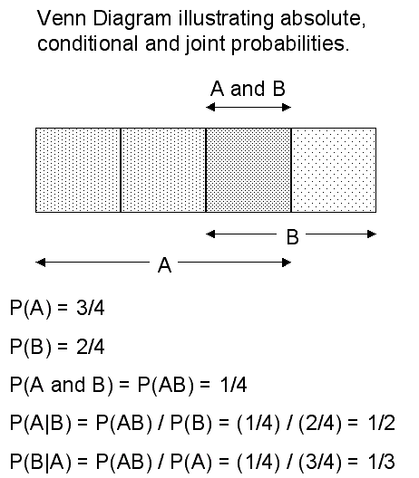
Bayes’ Theorem

Slide 17
Conditional Probability

Slide 18
Bayes' Theorem

Slide 19
Probability Information
Prior Probabilities
Initial beliefs or knowledge about an event (frequently subjective probabilities)
Likelihoods
Conditional probabilities that summarize the known performance characteristics of events (frequently objective, based on relative frequencies)

Slide 20
Circumstances for using Bayes’ Theorem
You have the opportunity, usually at a price, to get additional information before you commit to a choice
You have likelihood information that describes how well you should expect that source of information to perform
You wish to revise your prior probabilities

Slide 21
Problem
A company is planning to market a new product. The company’s marketing vice-president is particularly concerned about the product’s superiority over the closest competitive product, which is sold by another company. The marketing vice-president assessed the probability of the new product’s superiority to be 0.7. This executive then ordered a market survey to determine the products superiority over the competition.
The results of the survey indicated that the product was superior to its competitor.
Assume the market survey has the following reliability:
If the product is really superior, the probability that the survey will indicate “superior” is 0.8.
If the product is really worse than the competitor, the probability that the survey will indicate “superior” is 0.3.
After completion of the market survey, what should the vice-president’s revised probability assignment to the event “new product is superior to its competitors”?

Slide 22
Joint Probability Table
 | P(Ai) | P(B|Ai) | P(Ai)* P(B|Ai) | Revised Probability P(Ai|B)
A1 Probability product is superior | 0.7 | 0.8 | 0.56 | 0.56/0.65 = 0.86
A2 Probability product is not superior | 0.3 | 0.3 | 0.09 | 0.09/0.65 = 0.14
 | 1.0 | P(B) = | 0.65

